Slide 1



PROGRAMMING FUNDAMENTALS IN C
Loops

Slide 2

Objectives
The essentials of counter-controlled iteration.
To use the $for$, $while$ and $do…while$ iteration statements.
To use the $break$ and $continue$ statements to alter the flow of control.

Slide 3
Motivation
If you are required to write a program that prints your name 1000 times.
You can write 1000 lines to print your name
Use a loop
printf("My name is Omar");
printf("My name is Omar");
printf("My name is Omar");
.
.
.
printf("My name is Omar");
.
.
.
printf("My name is Omar");
for (int i = 0; i < 1000; i++) {
printf("My name is Omar");
}

Slide 4
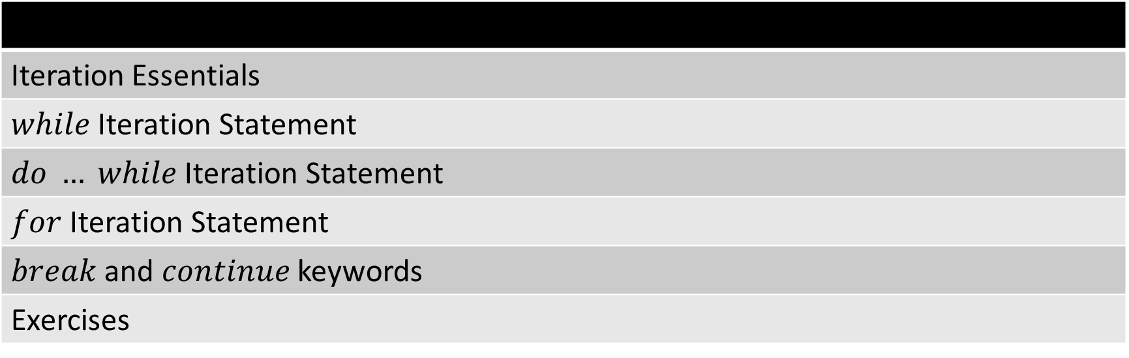
Content
Iteration Essentials
$while$ Iteration Statement
$do … while$ Iteration Statement
$for$ Iteration Statement
$break$ and $continue$ keywords
Exercises

Slide 5
Iteration Essentials
A loop is a group of instructions the computer executes repeatedly while some condition remains true.

Slide 6
Iteration Essentials
A loop is a group of instructions the computer executes repeatedly while some condition remains true.
Two ways to do iteration
Counter-controlled iteration
Sentinel-controlled iteration

Slide 7
Iteration Essentials
Counter-controlled iteration
Use a counter variable to determine how many times the loop will execute.
The control variable is incremented each time the group of instructions is performed.
When the value of the counter reaches the correct number of iterations required, the loop terminates and execution continues with the statement after the iteration statement.
Two ways to do iteration
Counter-controlled iteration
Sentinel-controlled iteration

Slide 8
Iteration Essentials
Sentinel-controlled iteration
Not known in advance how many times the loop will be executed.
It ends when an end-of-file is reached, or user input a certain value stops the loop.
Two ways to do iteration
Counter-controlled iteration
Sentinel-controlled iteration

Slide 9
Iteration Essentials
Counter-controlled iteration requires:
The name of a control variable (or loop counter).
The initial value of the control variable.
The increment (or decrement) by which the control variable is modified each time through the loop.
The condition that tests for the final value of the control variable (i.e., whether looping should continue).

Slide 10
Content
Iteration Essentials
$while$ Iteration Statement
$do … while$ Iteration Statement
$for$ Iteration Statement
$break$ and $continue$ keywords
Exercises

Slide 11
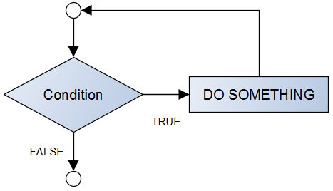
While Statement
Pseudocode
Flowchart
while(condition is true)
{
DO SOMETHING
}
Other statements

Slide 12
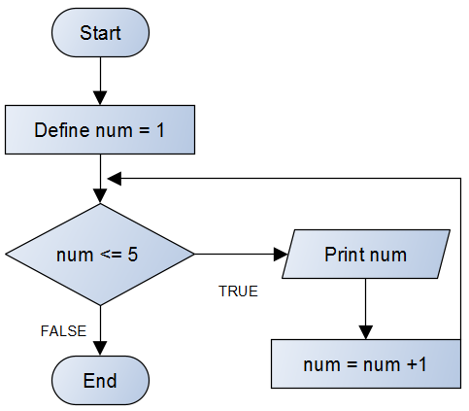
While Statement
Example
int num = 1; // control variable (counter)
while (num <= 5) // while the condition is true
{
printf("The number is %d\n", num);
num = num + 1; // Increment operation
}

Slide 13
Content
Iteration Essentials
$while$ Iteration Statement
$do … while$ Iteration Statement
$for$ Iteration Statement
$break$ and $continue$ keywords
Exercises

Slide 14
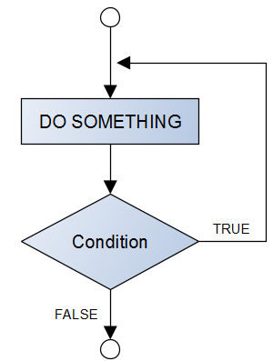
Do … While Statement
Pseudocode
Flowchart
do {
statements
} while (condition);

Slide 15
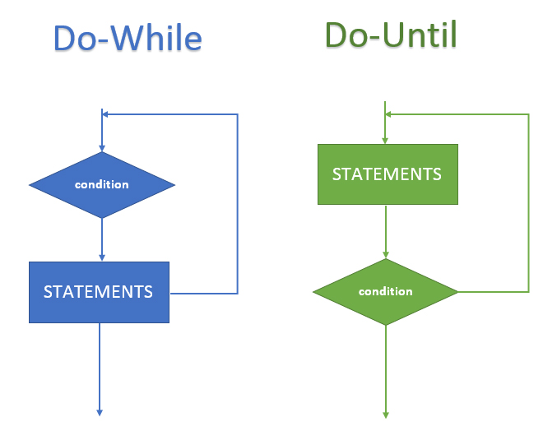
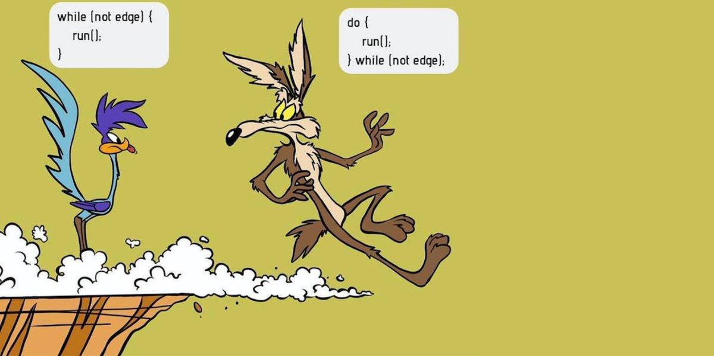

Do … While Statement
In the $while$ statement, the condition is tested at the beginning of the loop before the body of the loop is performed.
The $do…while$ statement tests the condition after the loop body is performed.
Therefore, the loop body will always execute at least once.

Slide 16
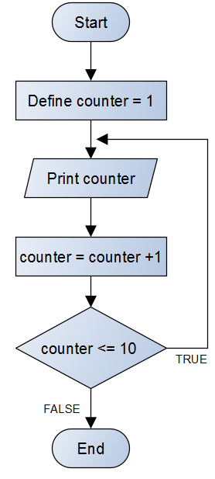
Do … While Statement
Example
int counter = 1;
do {
printf("%d ", counter);
counter += 1;
} while (counter <= 10);

Slide 17
Content
Iteration Essentials
$while$ Iteration Statement
$do … while$ Iteration Statement
$for$ Iteration Statement
$break$ and $continue$ keywords
Exercises

Slide 18
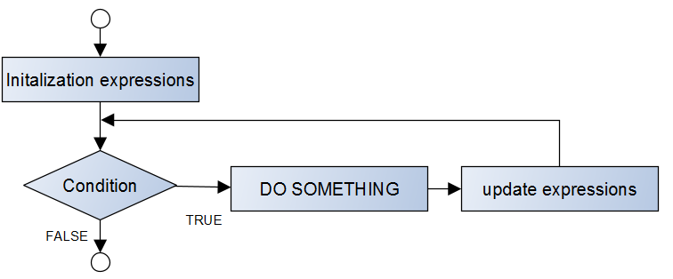

For Statement
The $for$ handles all the details of the loop in one line.
Pseudocode
Flowchart
For(initialization ; condition ; increment/decrement)
{
DO SOMETHING
}

Slide 19
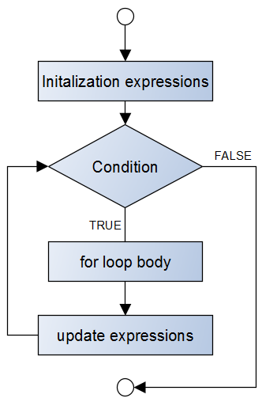
For Statement
Flowchart

Slide 20
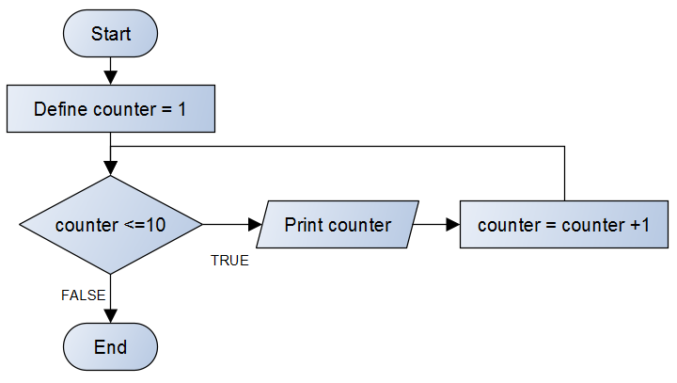
For Statement
Example
for (int counter = 1; counter <= 10; counter++)
{
printf("The counter is %d\n", counter);
}

Slide 21
Content
Iteration Essentials
$while$ Iteration Statement
$do … while$ Iteration Statement
$for$ Iteration Statement
$break$ and $continue$ keywords
Exercises

Slide 22
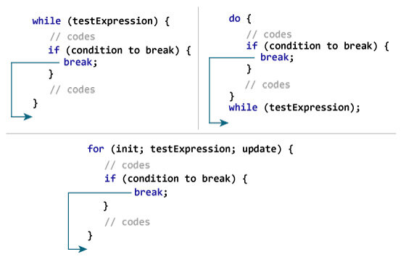
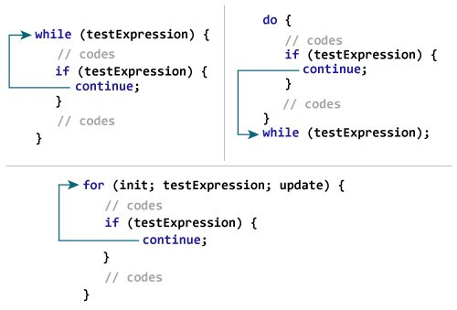

break and continue keywords
The $break$ and $continue$ statements are used to alter the flow of control.
The $break$ keyword breaks out of the loop (or $switch$ statements)
The $continue$ keyword skips the execution of the current iteration

Slide 23

break and continue keywords
$break$ example
unsigned int x; // declared here so it can be used after loop
// loop 10 times
for (x = 1; x <= 10; ++x)
{
// if x is 5, terminate loop
if (x == 5) {
// break loop only if x is 5
break;
}
printf("%u ", x);
}
printf("\nBroke out of loop at x == %u\n", x);

Slide 24

break and continue keywords
$continue$ example
// loop 10 times
for (int x = 1; x <= 10; ++x)
{
// if x is 5, continue with next iteration of loop
if (x == 5) {
continue; // skip remaining code in loop body
}
printf("%d ", x);
}
puts("\nUsed continue to skip printing the value 5");

Slide 25
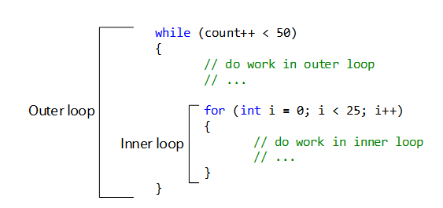

Notes and Observations
Loops can be nested
A $for$ loop can have inside it another loop ($while, do …while, for$)
Useful for multi-dimensional arrays.

Slide 26
Notes and Observations
Loops can be nested
Example
for (int i = 0; i < 10; i = (i + 1) * 2)
{
int x = 3;
while (x < (i + 3) * 2) {
puts("\tInner loop");
x++;
}
puts("Outer loop");
}

Slide 27

Notes and Observations
$break$ keyword breaks ONLY its loop
$continue$ keyword skips ONLY its loop
for (int i = 0; i < 10; i = (i + 1) * 2)
{
int x = 3;
while (x < (i + 3) * 2) {
printf("\tx = %d\n", x);
if (x == 2) {
break;
}
x++;
}
printf("i = %d\n", i);
}
for (int i = 0; i < 10; i = (i + 1) * 2) {
int x = 3;
while (x < (i + 3) * 2) {
printf("\tx = %d\n", x);
if (x == 2) {
continue;
}
x++;
}
printf("i = %d\n", i);
}

Slide 28
Notes and Observations
Variables defined inside a loop can’t be used outside it.
Variables defined outside the loop before it, can be used inside the loop
int x = 15;
int y = 20;
while (x > 5) {
printf("x is %d\n", x);
x--;
int number = 3;
printf("The number is %d\n",number);
number += 2;
}
puts("We are outside loop now");
printf("x is %d\n", x);
printf("y is %d\n", y);
printf("number is %d\n", number);

Slide 29
Notes and Observations
You can use logical operators within conditions
int x = 3;
int y = 20;
while (x > 5 || y > 5) {
x--;
y--;
}
printf("Now x is %d\nNow y is %d\n", x, y);

Slide 30

Notes and Observations
You can execute multiple expressions inside $for$ header using comma.
for (int i = 0, num = 5; i < 3 && num > 1; i += 1, num -= 1) {
printf("i = %d", i);
printf("\tnum = %d\n", num);
}

Slide 31
Notes and Observations
Sentinel-controlled iteration example
int num;
printf("Enter a number: ");
scanf("%d", &num);
while (num != 0) {
printf("You entered %d\n", num);
printf("Enter a number: ");
scanf("%d", &num);
}

Slide 32
Content
Iteration Essentials
$while$ Iteration Statement
$do … while$ Iteration Statement
$for$ Iteration Statement
$break$ and $continue$ keywords
Exercises

Slide 33
Exercise 01
Write a program to print numbers from 1 to 10.

Slide 34
Exercise 02
Write program to read set of numbers and print the sum of the number, if sum >=200 then print sum and end the program .

Slide 35
Exercise 03
(Find the Smallest) Write a program that finds the smallest of several integers. Assume that the first value read specifies the number of values to read.

Slide 36
Exercise 04
Write a program that reads an integer, and then prints the sum of the even and odd digits. For example, if the user enters 12245, the program outputs:
the sum of even digits is: 8
the sum of odd digits is: 6

Slide 37
Exercise 05
Write a program to print out all Armstrong numbers between 1 and 500. If sum of cubes of each digit of the number is equal to the number itself, then the number is called an Armstrong number. For example, 153 = ( 1 * 1 * 1 ) + ( 5 * 5 * 5 ) + ( 3 * 3 * 3 )

Slide 38
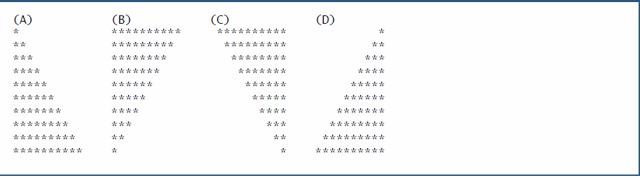

Exercise 06
(Triangle-Printing Program) Write a program that prints the following patterns separately, one below the other. Use for loops to generate the patterns. All asterisks (*) should be printed by a single $printf$ statement of the form $printf("\%s", "∗");$(this causes the asterisks to print side by side). [Hint: The last two patterns require that each line begin with an appropriate number of blanks.]

Slide 39
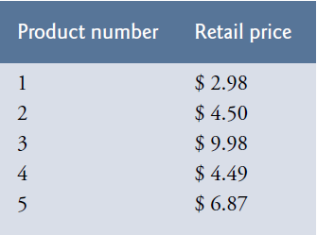

Exercise 07
(Calculating Sales) An online retailer sells five different products whose retail prices are shown in the following table:
Write a program that reads a series of pairs of numbers as follows:
a) Product number
b) Quantity sold for one day Your program should use a $switch$ statement to help determine the retail price for each product. Your program should calculate and display the total retail value of all products sold last week.

Slide 40
Exercise 08
Write a program to calculate HCF of two given number. HCF (Highest Common Factor) or GCD (Greatest Common Divisor) of two numbers is the largest number that divides both of them.

Slide 41
Exercise 09
Write a program to print Fibonacci series of n terms, where n is input by user. The Fibonacci sequence is a sequence where the next term is the sum of the previous two terms. The first two terms of the Fibonacci sequence are 0 followed by 1. For Example: 0, 1, 1, 2, 3, 5, 8, 13, 21, ... , (n-1th + n-2th)

Slide 42

Exercise 10
Do you know Super Mario game? We changed the game rules, Mario instead of avoiding the monsters by jumping he will fight them all. But because he is very weak, always he loses the fight and loses his health. At the beginning of the game Mario starts with health $100$, then he fights $n$ monsters. Each monster $i$ has a power $x_{i}$ and when Mario fights it, his health will be decreased by $x_{i}$. While Mario health is a positive value, he still alive otherwise he dead. You will be given the number of monsters $n$ and the power of each monster $x_{i}$. Can you tell us if Mario will be alive or be dead after fighting all monsters.

Slide 43
Exercise 11
(Binary Equivalent of a Decimal Number) Write a program to print the binary equivalent of a given decimal integer.

Slide 44
TASK 1
(Calculating Credit Limits) Collecting money becomes increasingly difficult during periods of recession, so companies may tighten their credit limits to prevent their accounts receivable (money owed to them) from becoming too large. In response to a prolonged recession, one company has cut its customers’ credit limits in half. Thus, if a particular customer had a credit limit of $2000 it’s now $1000. If a customer had a credit limit of $5000, it’s now $2500. Write a program that analyses the credit status of three customers of this company. For each customer you’re given: a) The customer’s account number. b) The customer’s credit limit before the recession. c) The customer’s current balance (i.e., the amount the customer owes the company). Your program should calculate and print the new credit limit for each customer and should determine (and print) which customers have current balances that exceed their new credit limits.

Slide 45
TASK 2
(Table of Decimal, Binary, Octal and Hexadecimal Equivalents) Write a program that prints a table of the binary, octal and hexadecimal equivalents of the decimal numbers in the range 1 through 256. [Note: You can display an integer as an octal or hexadecimal value with the conversion specifiers %o and %X, respectively.]

Slide 46
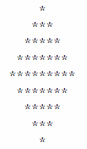

TASK 3
(Diamond-Printing Program) Write a program that prints the following diamond shape. You may use $printf$ statements that print either a single asterisk (*) or a single blank. Maximize your use of iteration (with nested for statements) and minimize the number of $printf$ statements.

Slide 47
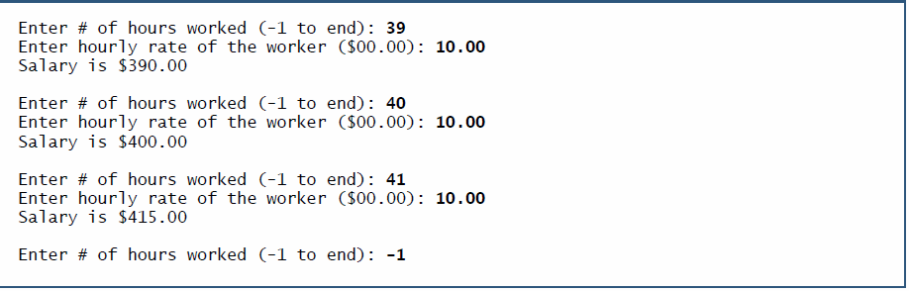
TASK 4
(Salary Calculator) Develop a program that will determine the gross pay for each of several employees. The company pays “straight time” for the first 40 hours worked by each employee and pays “time-and-a-half” for all hours worked in excess of 40 hours. You’re given a list of the employees of the company, the number of hours each employee worked last week and the hourly rate of each employee. Your program should input this information for each employee and should determine and display the employee's gross pay. Here is a sample input/output dialog:

Slide 48

TASK 5
(Tabular Output) Write a program that uses looping to print the following table of values. Use the tab escape sequence (\t), in the $printf$ statement to separate the columns with tabs.

Slide 49

TASK 6
(Sequences) Write $for$ statements that print the following sequences of values:
3, 8, 13, 18, 23, …, 993,998
20, 14, 8, 2, –4, –10, …, -994, -1000
3, 15, 75, 375, …, 46875, 234375
1, 2, 4, 8, 16, …, 4096, 8192

Slide 50
TASK 7
(Odd & even) Write a program that take an integer (n) from user then calculates and prints the product of odd integers from 1 to n and the summation of even integers from 1 to n.

Slide 51
TASK 08
(Factorials) The factorial function is used frequently in probability problems. The factorial of a positive integer n (written n! and pronounced “n factorial”) is equal to the product of the positive integers from 1 to n. Write a program that evaluates the factorials of the integers from 1 to 5. Print the results in tabular format.
What difficulty might prevent you from calculating the factorial of 20?

Slide 52
Final Notes
READ THE BOOK READ THE BOOK READ THE BOOK
READ THE BOOK READ THE BOOK READ THE BOOK
READ THE BOOK READ THE BOOK READ THE BOOK
READ THE BOOK READ THE BOOK READ THE BOOK
READ THE BOOK READ THE BOOK READ THE BOOK
READ THE BOOK READ THE BOOK READ THE BOOK
READ THE BOOK READ THE BOOK READ THE BOOK
READ THE BOOK READ THE BOOK READ THE BOOK
READ THE BOOK READ THE BOOK READ THE BOOK

Slide 53
Final Notes
MAKE ERRORS AND FIX THEM
SEARCH ONLINE FOR SOLUTIONS

